Slide 1
Electrician Job Projection and Electrical Consumption
By Jonathan Khan

Slide 2
Intro
The goal of my analysis is to identify a trend that can support the average percent change in job openings for electricians with the amount of electrical usage in NYC.
I used two data frames for my analysis. Labor Projections for New York State Years 2018-2021 and Electricity Consumption and Cost for New York City.
I believe the correlation between supply and demand fuel job markets. The necessity of these types of analysis should be stressed to signal uptrend/downtrend movements of the labor force.

Slide 3
Data Sources
I had found my data sources on data.gov and NYC open data.
The labor projections dataset was 13 Columns by 6629 rows.
The electrical consumption data set was 27 Columns by 362631 rows.
CSV files preference

Slide 4
Methodologies
I always find myself using pandas however I try to import more packages than I need just in case I might use them. Such as seaborn, numpy, matplotlib, etc.
I always begin by dropping columns I don’t need. In my code I constantly check the data frame to ensure that the code successfully executed.
I find that ID codes employers would normally use to organize data becomes useless after I have checked it for duplicates. In this case I dropped it in excel to save me some time before I imported the CSV file.

Slide 5


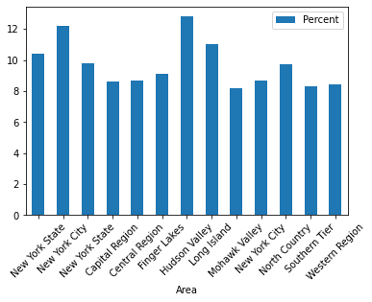
Methodologies (Continued)
I like to slice my data frames to have an overview of what I am looking at. Such as using the loc function to separate total occupational projection to form a new data frame separate from individual data like nursing, police officer etc.
I also sliced the original data set to focus on electrician data.
So, I created two data sets which I named df3 and df4.

Slide 6
Methodologies (Continued)
A line chart would have been preferable. However, I tried to convert the column that had the dates to a datetime data-type but I was unable to. It was a 10-year projection in this format : 2018-2028.
So instead, I choose a bar graph, which would also assist me in comparing percent averages. Just not as accurately and visually appealing as a line graph would have.

Slide 7
Methodologies (Continued)
The last order of business was to conduct an analysis on the electrical consumption data set.
This was a large data set that had a date set that I could easily manipulate.
So, I changed the date column from an object to datetime data-type while also extracting the year which was all I needed to gather the sum for each year.
I did a group by function with date and Consumption (KWH) on to a bar graph.

Slide 8
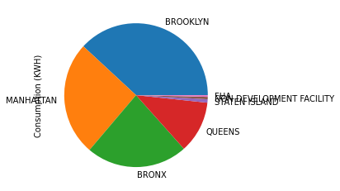
Methodologies (Final)
I was also curious as to where was the highest usage of electricity occurring in the city. So, I created a pie chart to represent that information by borough.

Slide 9
Conclusions
I based the idea behind my analysis on supply and demand. As to see some correlation between consumption and job outlook. Also, to see how this occupation compared with the state average.
In my first visualization, I compared the New York State Electrician job projection average to New York Cities projection. It was around the same, with NYS having a 9.8% growth rate and NYC having a 8.7% growth rate. Which is still under the state average for Electricians.

Slide 10
Conclusion (continued)
However, the city average which is 8.7 % is still lower when it comes to the average rate of change of NYC (12.2%) and NYS (10.4%) for all occupations.
The reason for this low rate of change I believe is because of the steady electrical consumption throughout NYC. Based off my visualizations there has been a steady increase in the amount of electrical usage. However, that increase has been around 8%. Which is around the same as the rate of change in jobs.

Slide 11
Conclusion (Final)
Another explanation for this steady rate of change could be the job entry requirements which require Electrical apprentices to have 5 years of OTJ training before becoming Master Electricians.
Lastly, another insight into my data that I found interesting was that Brooklyn had the most consumption of electricity in NYC. Based off my visualization I can assume that most jobs as an electrician or most job assignments located in Brooklyn.

